Slide 1
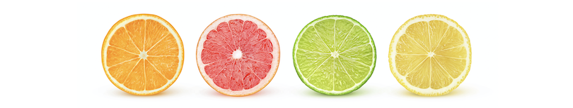
Customer Segmentation for online retail
Capstone 2022

Slide 2
Problem Statement
01
E-commerce is a highly competitive industry with an increasingly demanding customer base. It's not enough to simply set up an online store and assume that orders will come flooding in. You need to be constantly testing, learning and optimizing.
Growth is expected to continue in the e-commerce industry, which opens up many opportunities. In order to position for success in this growing space, I am engaged by a UK online retail company to analyse customer behaviour and make recommendations to optimize marketing and retention strategies.

Slide 3
Dataset
01
Feature | Description
Bill | A 6-digit integral number uniquely assigned to each transaction.
MerchandiseID | A 5-digit integral number uniquely assigned to each distinct product
Product | Name of the Product
Quota | The quantities of each product (item) per transaction
BillDate | Billing Date of transaction
Amount | Product price per unit
CustomerID | A 5 digit unique number assigned to each customer
Country | The name of the country where each customer resides
This is a transnational data set which contains all the transactions occurring between 01/12/2017 and 09/12/2019 for a UK-based and registered non-store online retail. The company mainly sells unique all-occasion gifts. Many customers of the company are wholesalers.
Online Retail Data Set : https://www.kaggle.com/coldperformer/customer-segmentation-using-rfm-k-means/data?select=RetailDataIII.csv

Slide 4
Goal
01
Identify and group customer segments using Recency, Frequency and Monetary Value (RFM) analysis with K-means clustering

Slide 5
Process
01
Data Cleaning
Exploratory Data Analysis (EDA)
1
Cohort Analysis
2
Recency, Frequency & Monetary (RFM)
3
K-means Clustering
4
Conclusion / Recommendation
5
6

Slide 6
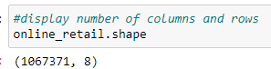
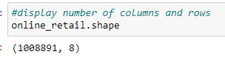
Data Cleaning
01
Remove Duplicates
Missing Data
Summary statistics
No. of duplicates: 34,337
Product: 4,275 (0.4%)
Negative values a. Quantity (1.9%)
b. Amount (5 transactions)
Due to adjustment of bad debt
Removed
Removed
Customer_id: 235,151 (22.8%)
Removed
Assign bill no. as unique customer ID

Slide 7
Exploratory Data Analysis (EDA)
Pre Profiling Report
01
02
03
Customers: 9203
Transactions: 40,297
Unique Products sold: 5462
04
05
06
Countries: 43
Higher transactions were fulfilled towards the end of the year
Majority of the customers were UK

Slide 8
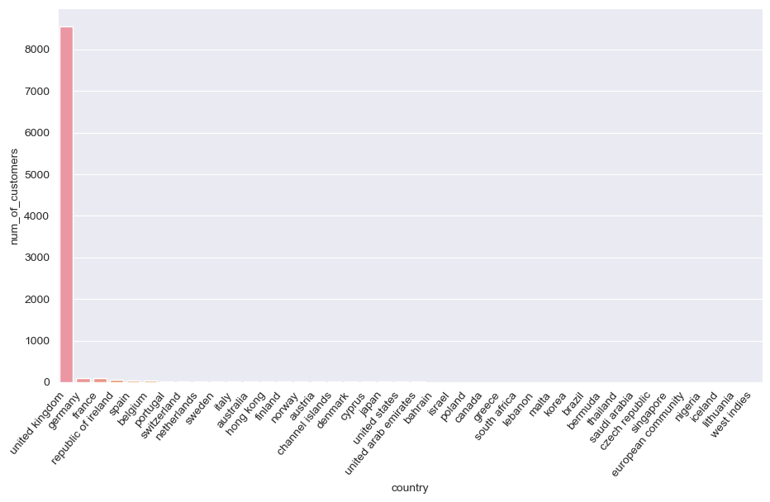
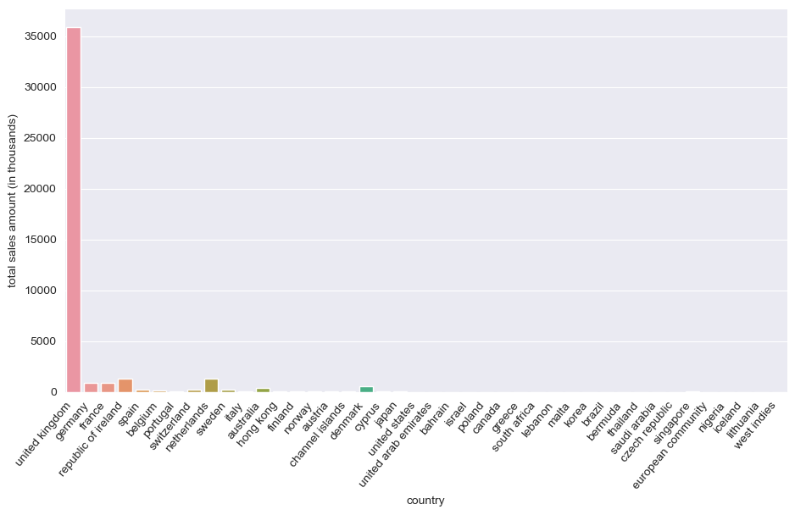
Exploratory Data Analysis (EDA)
Number of customers by country
93%
Total sales by country
84%

Slide 9

Exploratory Data Analysis (EDA)
UK
United Kingdom

Slide 10
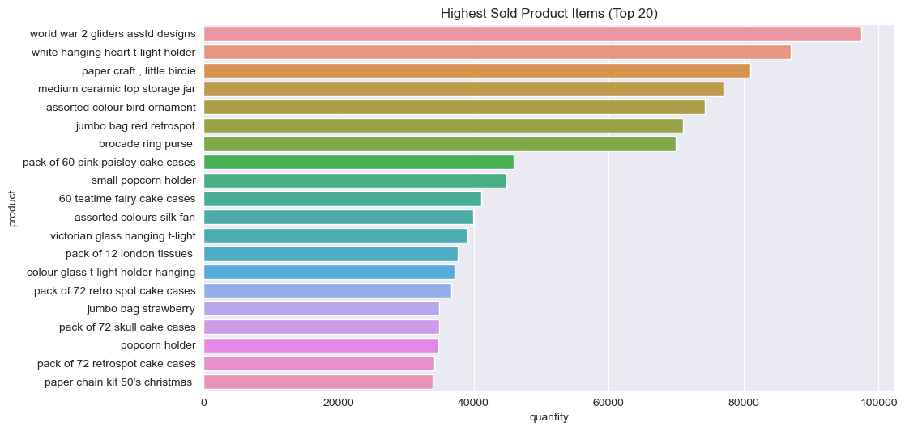


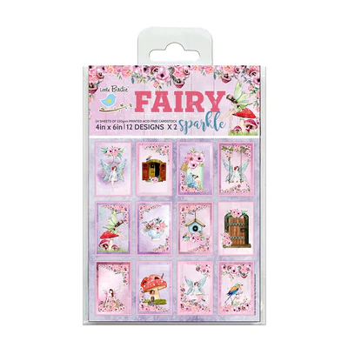
Exploratory Data Analysis (EDA)
UK
Products Sold

Slide 11
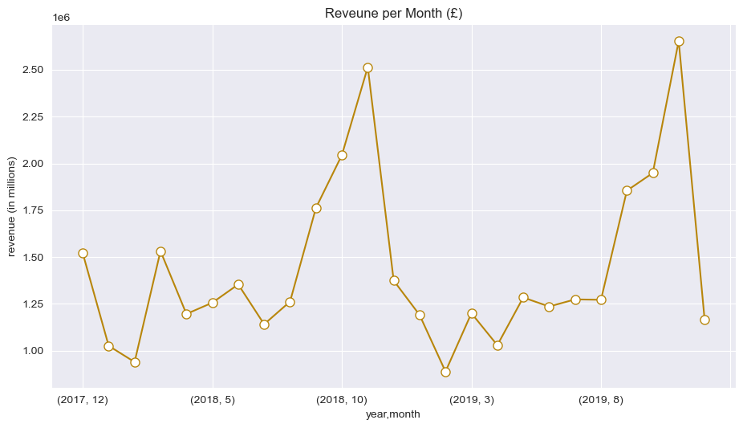
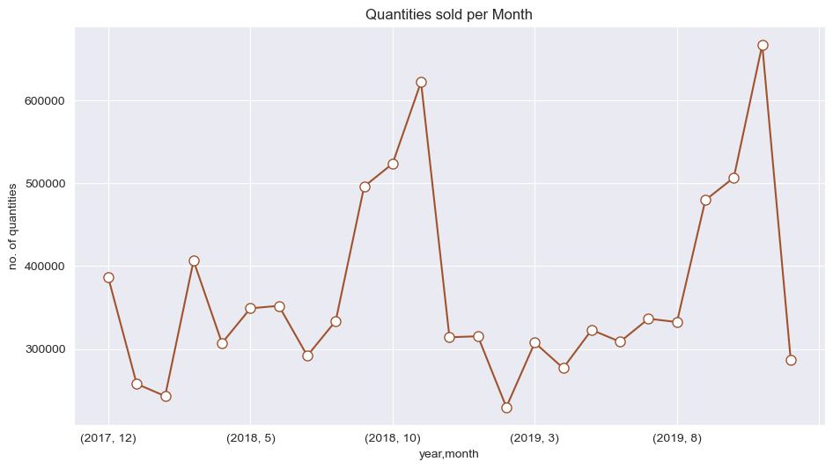
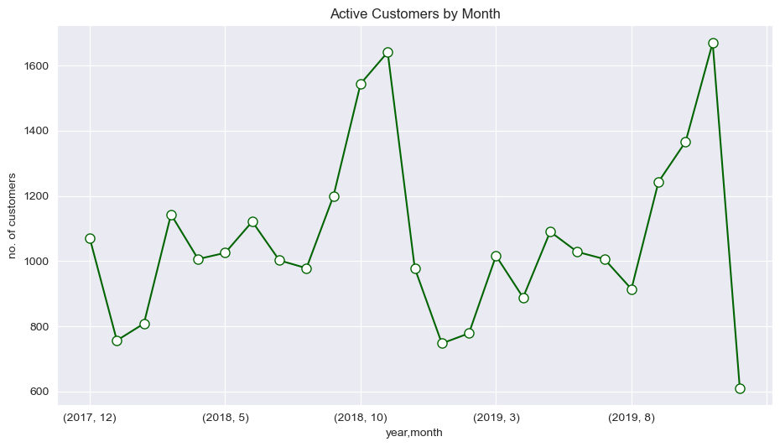
Exploratory Data Analysis (EDA)
UK
Nov
Revenue per Month
Nov
Quantities Sold per Month
Nov
Active Customers by Month

Slide 12
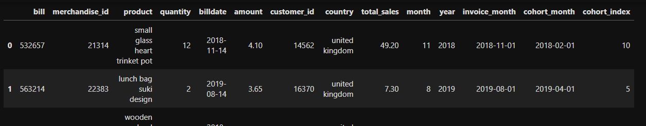
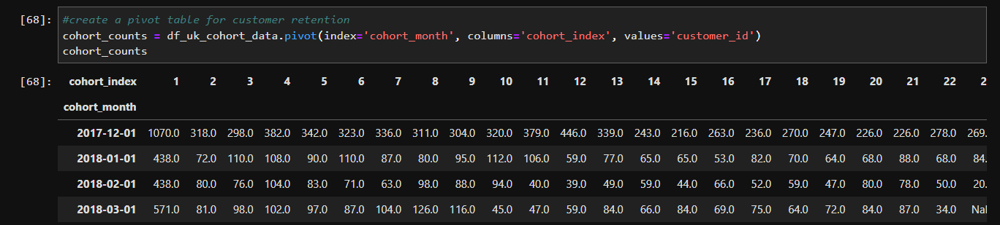
Cohort Analysis
for retention helps to understand how many customers continue to be active users in the days/weeks/months
UK
Time-Based Cohort Analysis
The customers are clustered into cohorts based on the month they made their purchase.
Difference by month
New features added
Assigning cohort
Earliest transaction made
Cohort Table for Customer Retention
One cohort
First month
Fifth month

Slide 13
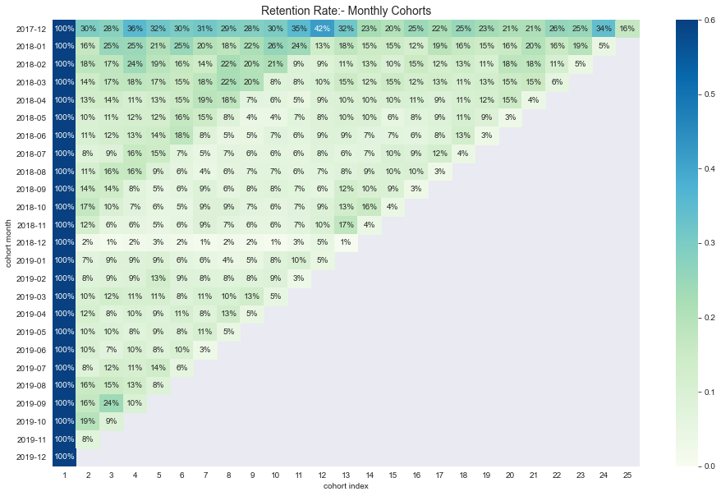
Cohort Analysis
UK
Convert to % and heatmap

Slide 14
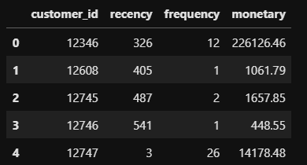
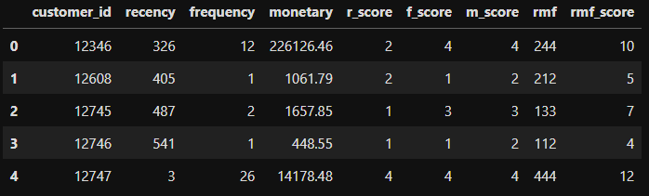
Recency How recently did the customer make a purchase? Frequency How often do they purchase? Monetary
How much do they spend?
UK
RFM analysis evaluates which customers are of highest and lowest value to an organization based on purchase recency, frequency, and monetary value, in order to understand their behaviors and reasonably predict which customers are more likely to make purchases again in the future.
RFM Table
Total sales amount
Date of the last purchase + 1 day
No. of bills
RFM Score
Obtain the score by quantile A. 25% = 1 B. 26% - 50% = 2 C. 51% - 75% = 3 D. 76% - 100% = 4

Slide 15
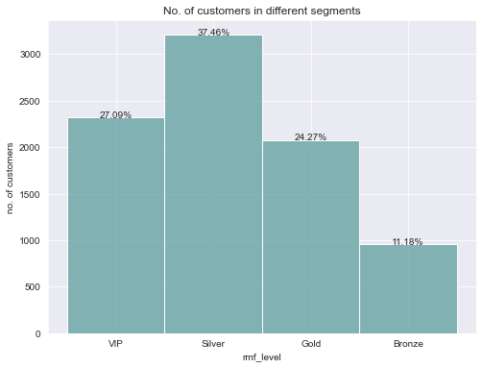
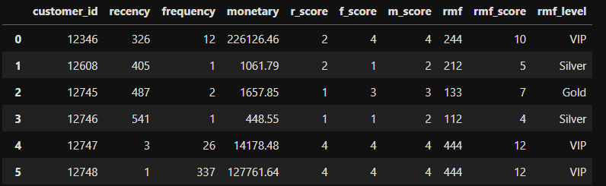
Clustering
UK
Custom segments
VIP : 10 to 12
Gold : 7 to 9
Silver : 4 to 6
Bronze : 1 to 3
OR we can gain further insight into customer behavior by applying k-means clustering

Slide 16
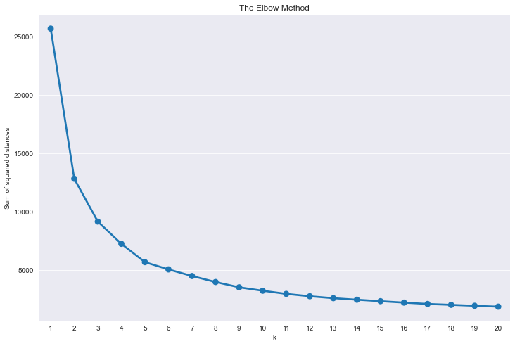
K-means
UK
Preprocessing
Distribution for RFM
Log transformation
StandardScaler
All are skewed to the right.
Reduce skewness
Standardise the data
Modeling
The Elbow Method

Slide 17
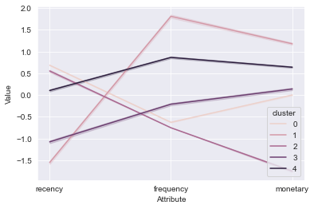
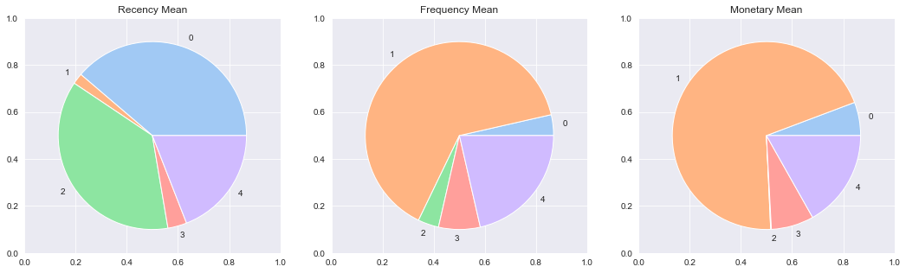
K-means
UK
Line Plot
Best : Cluster 1
Worst: Cluster 3
Pie Chart
Cluster 0 (Hibernating): Last transaction made was long time ago, below average purchase frequency with below average amount of monetary spending.
Cluster 1 (Champions): Had transactions recently, most frequent spenders with highest monetary spending amount.
Cluster 2 (Lost): One time purchase due to super cheap products on sales.
Cluster 3 (Promising): Had transactions recently, lower average purchase frequency with lower than average amount of monetary spending, perhaps they are still new to the platform and don't want to risk it.
Cluster 4 (At risk): Last transaction made was sometime back, low purchase frequency with low amount of monetary spending. Need to bring them back!

Slide 18
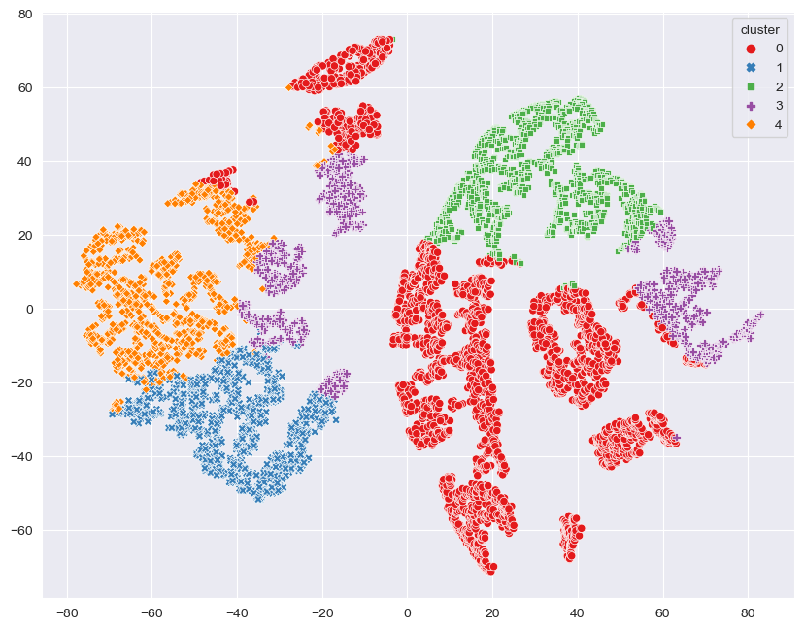
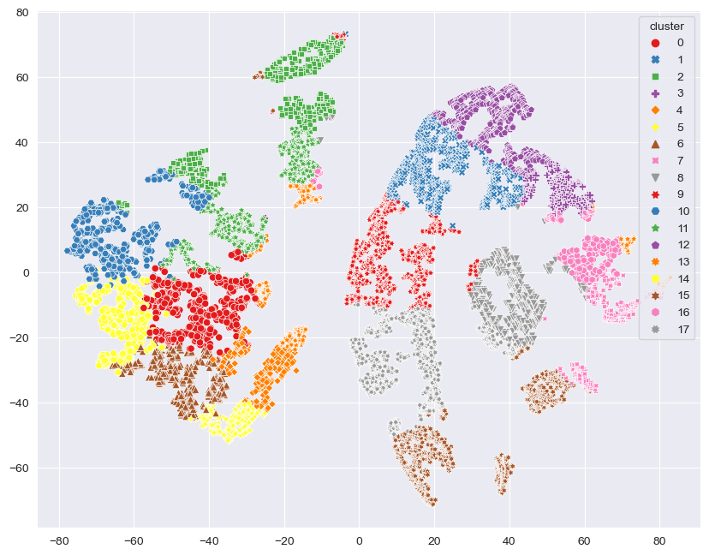
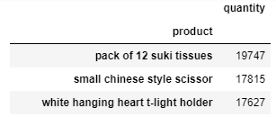
t-SNE
reduce the dimension into 2D
UK
UK
Cluster = 5
2
12
1
10
13
3
Cluster = 18
11
16
9
0
8
Top 3 products in cluster 6
14
7
4
17
6
5
15

Slide 19
Conclusion
To understand how the customers behave:
Cohort analysis to analyze customer retention rate.
RFM analysis to segregate customers into different clusters.
Scoring method (based on different quantiles) or K-means clustering.
RFM with K-means was chosen and will launch different marketing campaigns to different clusters.
To further enhance, t-SNE was used to break the clusters into smaller groups.

Slide 20
Recommendation
All customers:
Offer membership subscription
Loyalty program
Points system
Within same clusters: Each clusters should have their similarities. Hence, I will recommend products that are popular within the same cluster which the target customers have not purchase.
For different clusters:
Cluster | Category | Recommendation
0 | Hibernating | Offer / Recommend relevant products based on past purchases and give special discounts. Recreate brand value. Encourage repurchase.
1 | Champions | Need to retain, reward them! Upsell higher value products, engage them and ask them for reviews. Early release of new products to them.
2 | Lost | Send email or notification to bring awareness, ignore otherwise.
3 | Promising | Create brand awareness, giving discount on shipment fee.
4 | At risk | Send personalised emails and give vouchers with expiry dates
Notes:
Offer different tier of the membership
Loyalty program, extra benefits given to stay within certain level (spending per month)
$1 = 1 point

Slide 21
Improvement
More features:
Demographic Segmentation: age, sex, occupation, income, race, etc.
Geographic Segmentation: state, zip code, district
Behavioral Segmentation: online shopping habits (e.g. no. of clicks on certain products, usage rate, etc.)
Product Categories: to cluster by products
Future works:
Recommender system based on product reviews or historical purchase.

Slide 22
Thank You For your Attention

